Slide 1
Document and Meeting Workspaces

Slide 2
Agenda
The Purpose of Workspaces
Default Document and Meeting Workspaces
Publishing From a Workspace

Slide 3
The Purpose of Workspaces
Isolate Efforts
Prevent Premature Exposure
Provide Historical Information
Provide Preparatory or Supporting Information
Notes:
Workspaces in SharePoint 2010 are essentially web sites that provide a focused set of lists and libraries designed to provide supporting data for a particular event or document. On a community based platform, most sites provide an array of information targeted toward a wide audience such as a project team, department, division or the entire company. But sometimes a small select group of individuals need to work together on a document or participate in a meeting independently from the rest of the community. That’s where workspaces come in.
SharePoint 2010 offers two types of Workspaces: Document Workspaces and Meeting Workspaces. Both serve the similar purpose of resolving the following business needs:
Isolate Efforts: a separate site with independent permission settings can be isolated from the rest of the parent site’s target audience, giving a select group of users the opportunity to work in isolated confidence
Prevent Premature Exposure: documents and meeting details that are works in progress are only exposed to those business information workers responsible for authoring them until such time as they are published to a site available to the broader audience of intended readers
Provide Preparatory or Supporting Information: data unique to the purpose of working on a document or organizing a meeting can be held in the workspace with different quota limitations and tighter security to prevent the supporting information from impacting the administration of those sites intended for broader audiences
Provide Historical Information: workspaces can be retained after the meeting ends to refer to historical information such as a meeting’s minutes, attendees, agenda, or decision factor data as well as a document’s supporting data or decision factor data.

Slide 4
Agenda
The Purpose of Workspaces
Default Document and Meeting Workspaces
Publishing From a Workspace

Slide 5
Default Document & Meeting Workspaces
Document Workspace
Meeting Workspace
Basic
Blank
Decision
Multipage
Social
Notes:
SharePoint 2010 provides a document workspace site template and five meeting workspace site templates to help site creators design the appropriate environment for a team’s project or efforts. Only users who have the Create Subsites permission can create workspaces. This elevated privilege is limited to site owners by default.
As an end user, you may encounter any one of these default workspace types or a custom workspace that originated from one of them:
The following pages will describe each workspace in greater detail.

Slide 6
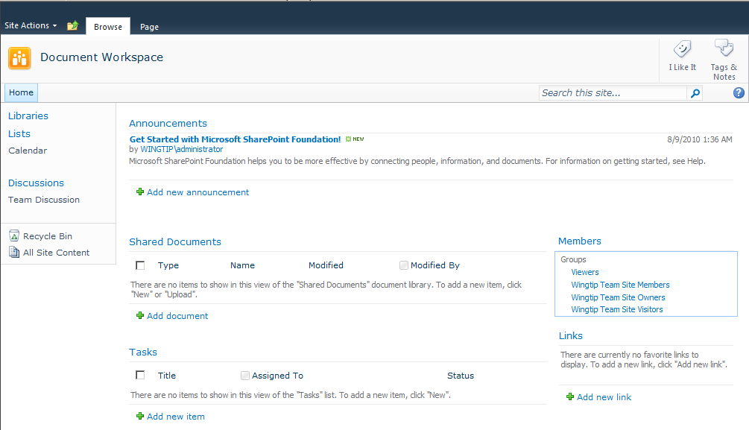
Document Workspace
Notes:
Document Workspaces are built to provide supporting information and justification for edits to a document or file. Imagine a team of 3-5 people working on changes to a corporate document. If their changes were prematurely exposed before the final proofread, the misinformation could cause confusion, a decrease in productivity or worse, unjustified panic and inappropriate decisions. If this team of authors was to work on the document while it resides in a library on a community site, chances of premature exposure are high. In addition to data that supports the document being available, as each author checks his or her changes to the document back into the library, there would be a period of time until the next author checks the document out that their changes could be read by non-editing users. To mitigate the possibility of the document or its supporting information leaking too early, a site administrator can send the document to a Document Workspace. The document of focus in a Document Workspace is called the primary document.
A Document Workspace can be an independent site or a subsite of the site in which an original copy of the document is being held. As such, the administrator of the Document Workspace can restrict permissions on the workspace so that only authors, editors and approvers of the primary document can access the workspace. Authors should be encouraged to store all supporting data for working on the primary document into the workspace rather than the higher level community site.
Document Workspaces are built with the following lists and libraries by default (though the site administrator or designer can change these):
Shared Document (library)
Announcements (list)
Calendar (list)
Links (list)
Tasks (list)
Team Discussion (list-discussion board)

Slide 7
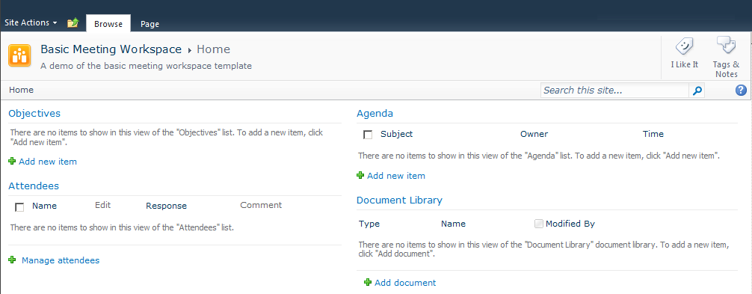
Basic Meeting Workspace
Notes:
Meeting Workspaces are useful before, during and after a meeting is held. Before a meeting, the workspace can be used to store preparatory information that attendees need to be familiar with prior to attending the discussion. By centrally managing prerequisite material in a workspace, all attendees receive a consistent stream of information thereby reducing delays during the actual meeting while time is spent hunting down current or correct information. During the meeting, the workspace can be referred to for discussion items, displays (such as PowerPoint presentations and the like), and recording minutes. After a meeting has concluded, information workers who need to refer back to the information or details from the meeting can simply re-visit the meeting workspace.
The Basic Meeting Workspace builds with a pre-defined set of lists and libraries that are somewhat universal (these can be changed by the site administrator or designer):
Document Library (library)
Agenda (list)
Attendees (list)
Objectives (list)
NOTICE: Meeting Workspaces do not display the familiar “Quick Launch” menu along the left edge of their pages like document workspaces and the other site templates unless you add additional pages to the workspace.

Slide 8
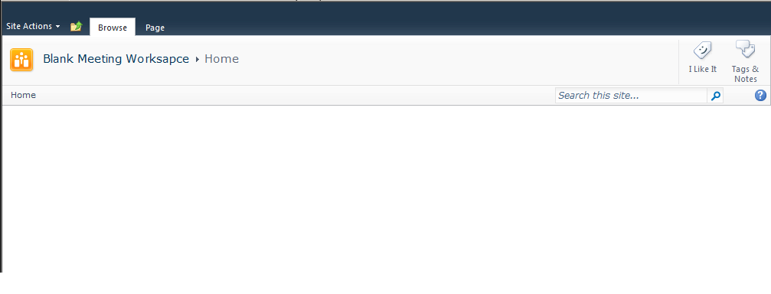
Blank Meeting Workspace
Notes:
Blank Meeting Workspace templates are appropriate when the site administrator requires special lists and libraries and doesn’t wish to suffer the extra time required to first decommission any pre-built lists or libraries. The Blank Meeting Workspace creates the site with only the hidden lists and libraries required by the SharePoint services to construct the site (such as a hidden Pages library) and an Attendees list (which is not exposed in any web part on any page by default).
Blank Meeting Workspaces take a lot more time and effort to design but once available, they function and perform like any other meeting workspace. To the business user visiting the meeting workspace that is well designed, there should not be any glaring indication the site was populated from a Blank Meeting Workspace template.

Slide 9
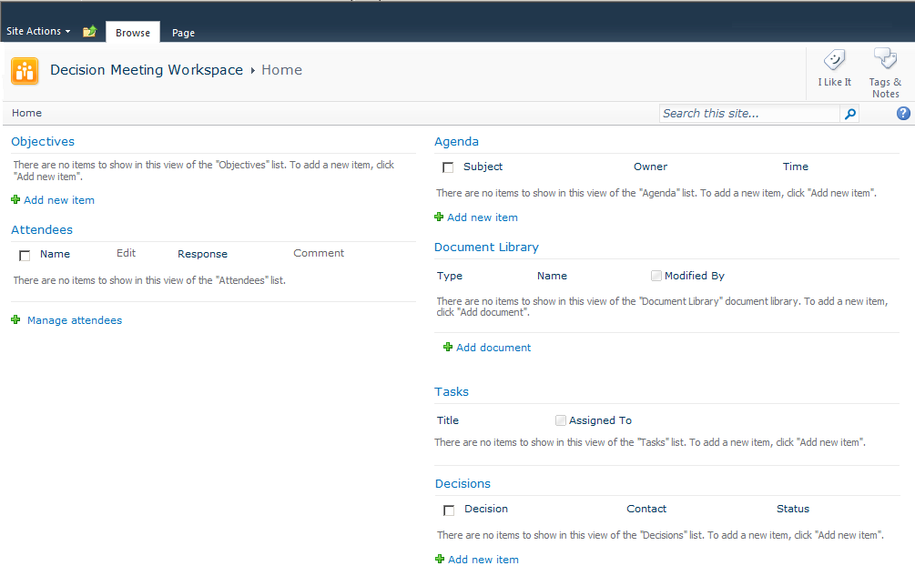
Decision Meeting Workspace
Notes:
The Decision Meeting Workspace is designed for tracking status of an ongoing business concern or tracking the debates leading up to a business decision. If a group of users will be meeting several times to discuss the progress of a certain project or decision, the meeting workspace can be associated with a recurring meeting so that all of the meeting dates and their information are held in a single workspace. If multiple dates are linked to the workspace, a menu of the dates will appear on the left side of the default page and users can click on the date for which they want to see the list or library items. Recurring events from a calendar can be supported by all of the meeting workspace templates, but the Decision Meeting Workspace is often the preferred template for them.
The following lists and libraries are built by default in a Decision Meeting Workspace (though site administrators and designers may change these):
Document Library (library)
Agenda (list)
Attendees (list)
Decisions (list)
Objectives (list)
Tasks (list)
NOTE: The Decision Meeting Workspace also makes a great template for recurring Project Status meetings. The Tasks list allows meeting organizers to assign deliverables to the project team members and track their completion at the next meeting.

Slide 10
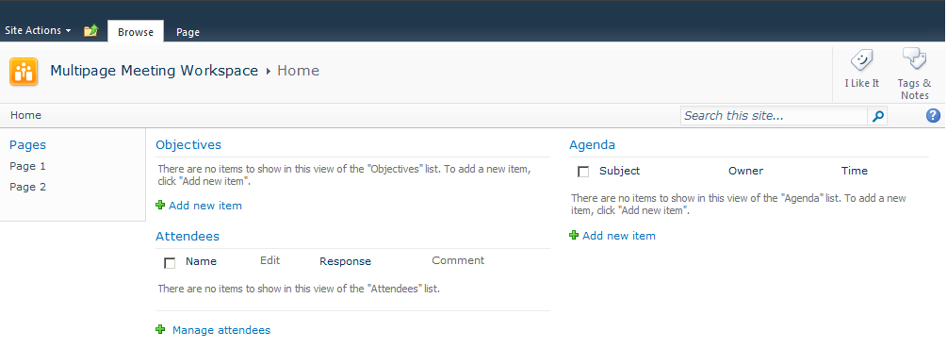
Multipage Meeting Workspace
Notes:
The Multipage Meeting Workspace provides multiple pages already built into the workspace by default. Like any other meeting workspace site that has had additional pages added to it manually, the Multipage Meeting Workspace displays a page list on the left side of its pages to help with navigation. Though only three pages are built during site creation (the default page, page 1 and page 2), more can be added manually by the site administrator or designer.
The following lists and libraries are built by default in a Multipage Meeting Workspace (though site administrators and designers may change these):
Agenda (list)
Attendees (list)
Objectives (list)
NOTE: Given the limited default lists in this template and the ability to create multiple pages in other templates, site administrators may opt for one of the other workspace templates in lieu of Multipage.

Slide 11
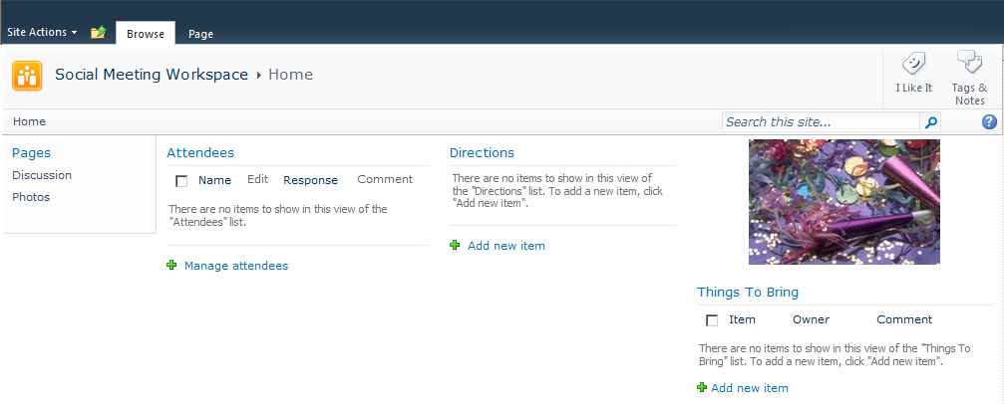
Social Meeting Workspace
Notes:
The Social Meeting Workspace exemplifies SharePoint’s commitment to user networking and the power of social technology. This meeting workspace template pre-defines lists and libraries that are conducive to social networking. And while social sites may seem counterproductive at first glance, they are powerful tools for fostering candid conversations that lead to more formal discussions or objectives for furthering the corporate agenda.
The following lists and libraries are built by default in a Social Meeting Workspace (though site administrators and designers may change these):
Picture Library (library)
Attendees (list)
Directions (list)
Things To Bring (list)
Discussion Board (list)
Also, the Social Meeting Workspace template constructs three pages for the workspace site. The main page (default.aspx) contains web parts that expose the Attendees, Directions and Things To Bring lists along with a picture from the Picture Library. The Discussion page exposes the Discussion Board list while the Photos page delivers the Picture Library. More pages can be added to the workspace if necessary.

Slide 12
DEMO
Document & Meeting Workspaces Overview
Notes:
In this demonstration, your instructor will:
Tour the default workspace sites available in SharePoint 2010 and point out the features and advantages of each.
Explore a meeting workspace built to accommodate a recurring meeting event.
Illustrate how to link a meeting workspace to a calendar list event.

Slide 13
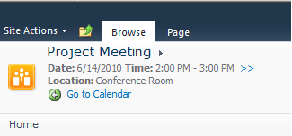
A Linked Meeting Workspace
Notes:
As a SharePoint Meeting Workspace user, be sure that you are navigating to the correct meeting before contributing to the workspace. The meeting associated with the workspace will be displayed at the top of the main page and includes the date and time (and time zone if you click on the “>>” link) as well as the location and a hyperlink back to the Calendar list housing the event itself.
Once a meeting workspace is associated with a particular event it cannot be associated with any other events. Each event can participate in a single workspace and each workspace can only be associated with a single event. This is called a one-to-one (1:1) relationship. If the event is a recurring event, it is still a single event it simply takes place repeatedly over time. As such, it can only be associated with a single workspace but that workspace will honor all future dates of the event using separate lists and libraries for each date.

Slide 14
Agenda
The Purpose of Workspaces
Default Document and Meeting Workspaces
Publishing From a Workspace

Slide 15
Document Workspace Review
Document Workspaces provide alternative storage for editing a “work in progress” document
The primary document in a Document Workspace library is the work in progress document, all other items are supporting data used to correctly edit the primary document.
At milestone intervals or once complete, the work in progress document from the Document Workspace needs to be published back to the origin community site
Notes:
As previously mentioned, Document Workspaces can be used to isolate efforts on a document that is not yet complete. Whether the authors, editors and approvers of these efforts are many business users or only a select few, by copying the document from a community site to a document workspace, the document can be assigned selective permissions and the work on the document and supporting data isolated to only those responsible for creating/updating the document.
While some site administrators may claim that the same can be accomplished by simply using item level security in the community site, to support similar levels of isolation on both the primary document and all of the supporting data used to work on that document, the granular security administration that would need to be performed across multiple lists and libraries on the community site would be counterproductive. By sending the primary document to a document workspace, permissions can be maintained once at the workspace (site) level and authors, editors and approvers can feel free to roam around the workspace as needed.
Periodically, authors and editors may wish to push the changes that have been made thus far on the primary document in the document workspace back up to the originating community site so that other users can see them. The process of sending changes from the workspace back to the broader audience community site is known as publishing the document. The document workspace retains the primary document copy even after publishing, in case the document isn’t completely finished but rather a block of changes needed to be published as part of a project delivery milestone. If, in fact, the document is truly complete, the primary document can be deleted from the document workspace and the workspace itself can be decommissioned.

Slide 16
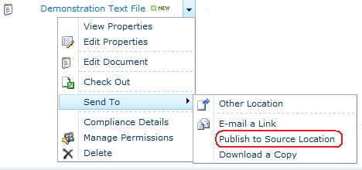
Publishing From a Document Workspace
Notes:
When a document is sent to a document workspace, the primary document item in the workspace’s document library bears the same item title and file name as the original. However, the primary document item in the workspace library gets new creation and modification metadata values reflecting the date and time that the document was sent to the workspace and by whom. As changes are made to the primary document in the workspace, the original document in the origin community site remains the version prior to having been sent to the workspace (for everyone other than the site administrator who sent the document to the workspace). If other users besides the site administrator attempt to edit the original copy in the community site’s library, their changes will not be saved.
When the primary document in the workspace is ready to be published back to the original library on the community site, known as the source location, a workspace user with at least the Edit Items permission to the source location can use the contextual drop-down menu on the primary document in the workspace library to Send To → Publish to Source Location. This is a different function than the Publish icon in the Documents ribbon of the library that publishes a major version of an item if the library uses Version Control.

Slide 17
Publishing From a Meeting Workspace
Relocate meeting details prior to decommissioning a meeting workspace
No direct publication mechanism like on a document workspace
Select carefully which data needs to be retained, such as attendance roster and minutes
Consider archiving the entire site if all information must be retained
Notes:
Unfortunately, meeting workspaces do not make it quite as easy to publish their content to a community site with a broader audience like document workspaces. To make meeting information available to a broader audience, the site administrator can either open up the security on the meeting workspace site itself or relocate certain list and library content to other community sites.
Therefore, as business information users you need to be selective about which meeting information truly needs to be retained beyond the lifespan of the meeting workspace. Sometimes this is dictated by government or industry regulations more than user preferences. If it turns out that the entire set of information on the meeting workspace needs to be made available to a broader audience, site administrators should use permissions on the existing meeting workspace. If instead the entire set of information on the meeting workspace needs to be retained but the workspace itself is a candidate for decommissioning, consider asking the site administrator to archive the site prior to decommission (i.e. back the site up to backup media or export it to an alternative location in SharePoint).

Slide 18
DEMO
Document Workspaces
Notes:
In this demonstration, your instructor will illustrate:
How to access a document workspace.
How to publish changes made to a work in progress document from its document workspace to its origin site.
How to publish meeting details from their meeting workspace to a collaborative site with a broader audience.

Slide 19
Summary
The Purpose of Workspaces
Default Document and Meeting Workspaces
Publishing From a Workspace

